Slide 1
Chapter 13: Concurrency Control
Hector Garcia-Molina
CS 245
Notes 09
1

Slide 2

Concurrency Control
T1 T2 … Tn
DB
(consistency constraints)

Slide 3
Example:
T1: Read(A) A ← A+100 | T2: | Read(A) A ← A×2
Write(A) |  | Write(A)
Read(B) B ← B+100 Write(B) |  | Read(B) B ← B×2 Write(B)
Constraint: A=B

Slide 4
Schedule A
A | B
25 | 25
125
 | 125
250
 | 250
250 | 250
T1
Read(A); A ← A+100
Write(A);
Read(B); B ← B+100;
Write(B);
T2
Read(A);A ← A×2; Write(A); Read(B);B ← B×2; Write(B);

Slide 5
Schedule B
A | B
25 | 25
50
 | 50
150
 | 150
150 | 150
T1
T2
Read(A);A ← A×2; Write(A);
Read(B);B ← B×2; Write(B);
Read(A); A ← A+100
Write(A);
Read(B); B ← B+100;
Write(B);

Slide 6
Schedule C
A | B
25 | 25
125
250
 | 125
 | 250
250 | 250
T1
Read(A); A ← A+100
Write(A);
T2
Read(A);A ← A×2; Write(A);
Read(B);B ← B×2; Write(B);
Read(B); B ← B+100;
Write(B);

Slide 7
Schedule D
A | B
25 | 25
125
250
 | 50
 | 150
250 | 150
T1
Read(A); A ← A+100
Write(A);
T2
Read(A);A ← A×2; Write(A); Read(B);B ← B×2; Write(B);
Read(B); B ← B+100;
Write(B);

Slide 8
Schedule E
Same as Schedule D but with new T2’
A | B
25 | 25
125
125
 | 25
 | 125
125 | 125
T1
Read(A); A ← A+100
Write(A);
T2’
Read(A);A ← A×1; Write(A); Read(B);B ← B×1; Write(B);
Read(B); B ← B+100;
Write(B);

Slide 9
Want schedules that are “good”, regardless of不管
initial state and初始态
transaction semantics事务语义
Only look at order of read and writes
Example:
Sc=r1(A)w1(A)r2(A)w2(A)r1(B)w1(B)r2(B)w2 (B)

Slide 10
Example: Sc=r1(A)w1(A)r2(A)w2(A)r1(B)w1(B)r2(B)w2(B)
Sc’=r1(A)w1(A) r1(B)w1(B)r2(A)w2(A)r2(B)w2(B)
T1 T2

Slide 11
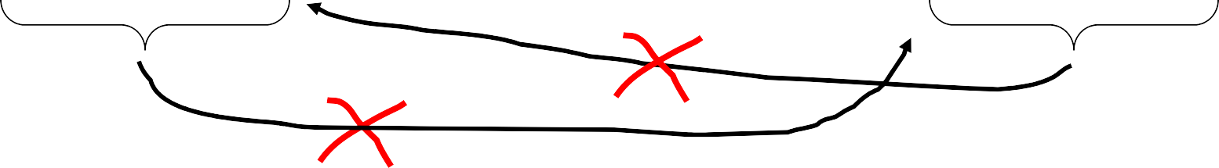
However, for Sd:
Sd=r1(A)w1(A)r2(A)w2(A) r2(B)w2(B)r1(B)w1(B)
as a matter of fact,
T2 must precede 在..之前T1
in any equivalent schedule, i.e., T2 → T1

Slide 12
T2 → T1
Also, T1 → T2
Sd cannot be rearranged重新排列into a serial schedule
Sd is not “equivalent” to any serial schedule
Sd is “bad”
T1 T2

Slide 13
Returning to Sc
Sc=r1(A)w1(A)r2(A)w2(A)r1(B)w1(B)r2(B)w2(B)
T1 → T2 T1 → T2
 no cycles ⇒ Sc is “equivalent” to a
serial schedule
(in this case T1,T2)

Slide 14

Concepts
Transaction:sequence of ri(x), wi(x) actions
Conflicting actions: r1(A)
w2(A)
w2(A)
r1(A)
w1(A)
w2(A)
Schedule:represents chronological执行order in which actions are executed
Serial schedule序列时间表:no interleaving交错of actions or transactions

Slide 15
What about concurrent actions?
Ti issues System read(x,t) issues
input(x)
Input(X) t ← x completes
time
T2 issues write(B,S)
input(B) completes
System issues output(B)
System issues input(B)
output(B)
B ← S
completes

Slide 16
So net effect is either
S=…r1(x)…w2(b)… or
S=…w2(B)…r1(x)…

Slide 17
What about conflicting, concurrent actions on same object?
start r1(A) end r1(A)
start w2(A) end w2(A)
time
Assume equivalent to either r1(A) w2(A)
or w2(A) r1(A)
⇒ low level synchronization mechanism同步机制
Assumption called “atomic actions”

Slide 18
Definition
S1, S2 are conflict equivalent schedules冲突等价调度 if S1 can be transformed into S2 by a
series of swaps on non-conflicting actions.

Slide 19
Definition
A schedule is conflict serializable可冲突序列化 if it is conflict equivalent to some serial schedule.

Slide 20
Precedence graph优先级图 P(S) (S is schedule)
Nodes: transactions in S Arcs: Ti → Tj whenever
pi(A), qj(A) are actions in S
pi(A) <_{S} qj(A)
at least one of pi, qj is a write

Slide 21
Exercise:
What is P(S) for
S = w3(A) w2(C) r1(A) w1(B) r1(C) w2(A) r4(A) w4(D)
Is S serializable?

Slide 22
Another Exercise:
What is P(S) for
S = w1(A) r2(A) r3(A) w4(A) ?

Slide 23
Lemma引理
S1, S2 conflict equivalent ⇒ P(S1)=P(S2) Proof:
Assume P(S1) ≠ P(S2)
⇒ ∃ Ti: Ti → Tj in S1 and not in S2
⇒ S1 = …pi(A)... qj(A)…
S2 = …qj(A)…pi(A)...
pi, qj conflict
⇒ S1, S2 not conflict equivalent

Slide 24
Note: P(S1)=P(S2) ⇒ S1, S2 conflict equivalent
Counter example:
S1=w1(A) r2(A)
w2(B) r1(B)
S2=r2(A) w1(A)
r1(B) w2(B)

Slide 25
Theorem
P(S1) acyclic 非循环⇐⇒ S1 conflict serializable (⇐) Assume S1 is conflict serializable
⇒ ∃ Ss: Ss, S1 conflict equivalent
⇒ P(Ss) = P(S1)
⇒ P(S1) acyclic since P(Ss) is acyclic

Slide 26

Theorem
P(S1) acyclic ⇐⇒ S1 conflict serializable
T1
(⇒) Assume P(S1) is acyclic Transform S1 as follows:
T2 T3 T4
Take T1 to be transaction with no incident arcs
Move all T1 actions to the front
S1 = ……. qj(A)…….p1(A)…..
we now have S1 = < T1 actions ><... rest ...>
repeat above steps to serialize rest!

Slide 27
How to enforce serializable schedules?
Option1: run system, recording P(S); at end of day, check for P(S)
cycles and declare if execution was good

Slide 28

How to enforce serializable schedules?
Option2:prevent P(S) cycles from
occurring
T1 T2 ….. Tn
Scheduler
DB

Slide 29
A locking protocol锁协议
Two new actions: lock (exclusive): unlock:
li (A)
ui (A)
T1 T2
 |  |  | lock table
scheduler

Slide 30

Rule #1: Well-formed transactions
Ti: … li(A) … pi(A) … ui(A) ...

Slide 31



Rule #2 Legal scheduler
S = …….. li(A) ………... ui(A) ……...
no lj(A)

Slide 32
Exercise:
What schedules are legal?
What transactions are well-formed?
S1 = l1(A)l1(B)r1(A)w1(B)l2(B)u1(A)u1(B)
r2(B)w2(B)u2(B)l3(B)r3(B)u3(B)
S2 = l1(A)r1(A)w1(B)u1(A)u1(B)
l2(B)r2(B)w2(B)l3(B)r3(B)u3(B)
S3 = l1(A)r1(A)u1(A)l1(B)w1(B)u1(B)
l2(B)r2(B)w2(B)u2(B)l3(B)r3(B)u3(B)

Slide 33





Exercise:
What schedules are legal?
What transactions are well-formed?
S1 = l1(A)l1(B)r1(A)w1(B)l2(B)u1(A)u1(B)
r2(B)w2(B)u2(B)l3(B)r3(B)u3(B)
S2 = l1(A)r1(A)w1(B)u1(A)u1(B)
l2(B)r2(B)w2(B)l3(B)r3(B)u3(B)
S3 = l1(A)r1(A)u1(A)l1(B)w1(B)u1(B)
l2(B)r2(B)w2(B)u2(B)l3(B)r3(B)u3(B)

Slide 34
Schedule F
T1
l1(A);Read(A)
A A+100;Write(A);u1(A)
T2
l2(A);Read(A)
Ax2;Write(A);u2(A)
l2(B);Read(B)
Bx2;Write(B);u2(B)
l1(B);Read(B)
B B+100;Write(B);u1(B)

Slide 35
Schedule F
A B
T1
l1(A);Read(A)
A A+100;Write(A);u1(A)
T2
25 25
125
250
50
150
250 150
l2(A);Read(A)
Ax2;Write(A);u2(A)
l2(B);Read(B)
Bx2;Write(B);u2(B)
l1(B);Read(B)
B B+100;Write(B);u1(B)

Slide 36
Rule #3 Two phase locking (2PL)
两相锁定（2PL） for transactions
Ti = ……. li(A) ………... ui(A) ……...
no unlocks
no locks

Slide 37


# locks held by Ti
Time
Growing Phase
Shrinking Phase

Slide 38

Schedule G
T1
l1(A);Read(A)
A A+100;Write(A) l1(B); u1(A)
T2
delayed
A Ax2;Write(A);l2(B)
l2(A);Read(A)

Slide 39

Schedule G
T1
l1(A);Read(A)
A A+100;Write(A) l1(B); u1(A)
Read(B);B B+100
Write(B); u1(B)
T2
delayed
A Ax2;Write(A);l2(B)
l2(A);Read(A)

Slide 40

Schedule G
T1
l1(A);Read(A)
A A+100;Write(A) l1(B); u1(A)
Read(B);B B+100
Write(B); u1(B)
T2
delayed
A Ax2;Write(A);l2(B)
l2(A);Read(A)
l2(B); u2(A);Read(B)
B Bx2;Write(B);u2(B);

Slide 41


Schedule H
(T2 reversed)
T1
T2
l1(A); Read(A)
A A+100;Write(A)
l2(B);Read(B)
B Bx2;Write(B)
l1(B)
l2(A)
delayed
delayed

Slide 42
Assume deadlocked transactions are rolled back
They have no effect
They do not appear in schedule
E.g., Schedule H =
This space intentionally left blank!

Slide 43
Next step:
Show that rules #1,2,3 ⇒ conflict-
serializable schedules

Slide 44
Conflict rules for li(A), ui(A):
li(A), lj(A) conflict
li(A), uj(A) conflict
Note: no conflict < ui(A), uj(A)>, < li(A), rj(A)>,...

Slide 45
Theorem Rules #1,2,3 ⇒ conflict
(2PL)
serializable schedule
To help in proof:
Definition
Shrink(Ti) = SH(Ti) = first unlock action of Ti

Slide 46
Lemma
Ti → Tj in S ⇒ SH(Ti) <_{S}
Proof of lemma:
Ti → Tj means that
S = … pi(A) … qj(A) …; By rules 1,2:
SH(Tj)
p,q conflict
S = … pi(A) … ui(A) … lj(A) ... qj(A) … By rule 3: SH(Ti) SH(Tj)
So, SH(Ti) <_{S} SH(Tj)

Slide 47
Theorem Rules #1,2,3 ⇒ conflict
(2PL)
serializable schedule
Proof:
Assume P(S) has cycle
T1 → T2 →…. Tn → T1
By lemma: SH(T1) < SH(T2) < ... < SH(T1)
Impossible, so P(S) acyclic
⇒ S is conflict serializable

Slide 48
Beyond this simple 2PL protocol, it is all a matter of improving performance and allowing more concurrency….
Shared locks
Multiple granularity
Inserts, deletes and phantoms
Other types of C.C. mechanisms

Slide 49
Shared locks
So far:
S = ...l1(A) r1(A) u1(A) … l2(A) r2(A) u2(A) …
Do not conflict
Instead:
S=... ls1(A) r1(A) ls2(A) r2(A) …. us1(A) us2(A)

Slide 50
Lock actions
l-ti(A): lock A in t mode (t is S or X) u-ti(A): unlock t mode (t is S or X)
Shorthand:
ui(A): unlock whatever modes
Ti has locked A

Slide 51
Rule #1 Well formed transactions
Ti =... l-S1(A) … r1(A) … u1 (A) …
Ti =... l-X1(A) … w1(A) … u1 (A) …

Slide 52
What about transactions that read and write same object?
Option 1: Request exclusive lock
Ti = ...l-X1(A) … r1(A) ... w1(A) ... u(A) …

Slide 53
Option 2: Upgrade
What about transactions that read and write same object?
(E.g., need to read, but don’t know if will write…)
Ti=... l-S1(A) … r1(A) ... l-X1(A) …w1(A)
...u(A)…
Think of
Get 2nd lock on A, or
Drop S, get X lock

Slide 54
Rule #2 Legal scheduler
S = ....l-Si(A) … … ui(A) …
no l-Xj(A)
S = ... l-Xi(A) … … ui(A) …
no l-Xj(A)
no l-Sj(A)

Slide 55
A way to summarize Rule #2
Compatibility matrix
Comp
 | S | X
S | true | false
X | false | false

Slide 56
Rule # 3 2PL transactions
No change except for upgrades:
If upgrade gets more locks
(e.g., S → {S, X}) then no change!
If upgrade releases read (shared) lock (e.g., S → X)
- can be allowed in growing phase

Slide 57
Theorem Rules 1,2,3 ⇒ Conf.serializable for S/X locks schedules
Proof: similar to X locks case
Detail:
l-ti(A), l-rj(A) do not conflict if comp(t,r) l-ti(A), u-rj(A) do not conflict if comp(t,r)

Slide 58
Lock types beyond S/X
Examples:
increment lock
update lock

Slide 59
Example (1): increment lock
Atomic increment action: INi(A)
{Read(A); A ← A+k; Write(A)}
INi(A), INj(A) do not conflict!
INi(A)
+2
+10
INj(A)
A=7
INj(A)
+10
+2
INi(A)
A=5
A=17
A=15

Slide 60
Comp
 | S | X | I
S
X
I

Slide 61
Comp
 | S | X | I
S | T | F | F
X | F | F | F
I | F | F | T

Slide 62
Update locks
A common deadlock problem with upgrades:
T1 T2
l-S1(A)
l-S2(A)
l-X1(A)
l-X2(A)
--- Deadlock ---

Slide 63
Solution
If Ti wants to read A and knows it may later want to write A, it requests update lock (not shared)

Slide 64
New request
Comp
Lock already held in
 | S | X | U
S
X
U

Slide 65
New request
Comp
Lock already held in
-> symmetric table?
 | S | X | U
S | T | F | T
X | F | F | F
U | TorF | F | F

Slide 66
Note: object A may be locked in different modes at the same time...
S1=...l-S1(A)…l-S2(A)…l-U3(A)… l-S4(A)…?
l-U4(A)…?
To grant a lock in mode t, mode t must be compatible with all currently held locks on object

Slide 67
How does locking work in practice?
Every system is different
(E.g., may not even provide
CONFLICT-SERIALIZABLE schedules)
But here is one (simplified) way ...

Slide 68
Sample Locking System:
Don’t trust transactions to
request/release locks
Hold all locks until transaction
commits
#
locks
time

Slide 69


Ti
Read(A),Write(B)
lock table
Scheduler, part I
l(A),Read(A),l(B),Write(B)…
Scheduler, part II
Read(A),Write(B)
DB

Slide 70
Lock table
Conceptually
If null, object is unlocked
A B C
Λ
Every possible object
Lock info for B
Lock info for C
Λ
...

Slide 71
But use hash table:
A
H
...
A
Lock info for A
...
If object not found in hash table, it is unlocked

Slide 72

Lock info for A - example
Object:A Group mode:U Waiting:yes List:
_{S} e _{no} ?
tran
mod
wait
Nxt
T_lin
k
T1
T2
U
no
T3
yes Λ
To other T3 records

Slide 73
What are the objects we lock?
Tuple A Tuple B Tuple C
Relation A
Relation B
Disk block A
Disk block B
...
...
?
...
DB
DB
DB

Slide 74
Locking works in any case, but should we choose small or large objects?
If we lock large objects (e.g., Relations)
Need few locks
Low concurrency
If we lock small objects (e.g., tuples,fields)
Need more locks
More concurrency

Slide 75
We can have it both ways!!
Ask any janitor to give you the solution...
Stall 1
Stall 2
Stall 3
Stall 4
restroom
hall

Slide 76
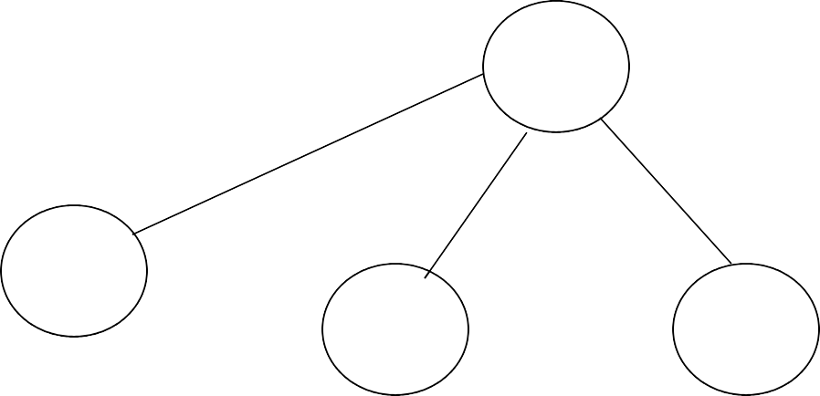

Example
T1(IS) , T2(S)
R1
t1
t2
T1(S)
t4
t3

Slide 77

Example
T1(IS) , T2(IX)
R1
t1
t2
T1(S)
t4
t3
T2(IX)

Slide 78
Multiple granularity
Comp
Requestor
X
IS
IX
S
SI
X
IS
Holder IX
S
SIX
X

Slide 79
Multiple granularity
Comp Requestor
T T T T ^{X} F T T F F F T F T F F T F F F F F F F F F
IS
IX
S
SI
X
IS
Holder IX
S
SIX
X

Slide 80

Child can be locked in
Parent locked in
P
IS IX
S
C
SIX X

Slide 81

Child can be locked
by same transaction in
Parent locked in
IS
IS, S
P
IX
IS, S, IX, X, SIX
S
[S, IS] not necessary X, IX, [SIX]
SIX X
C
none

Slide 82
Rules
Follow multiple granularity comp function
Lock root of tree first, any mode
Node Q can be locked by Ti in S or IS only if parent(Q) locked by Ti in IX or IS
Node Q can be locked by Ti in X,SIX,IX only if parent(Q) locked by Ti in IX,SIX
Ti is two-phase
Ti can unlock node Q only if none of Q’s children are locked by Ti

Slide 83






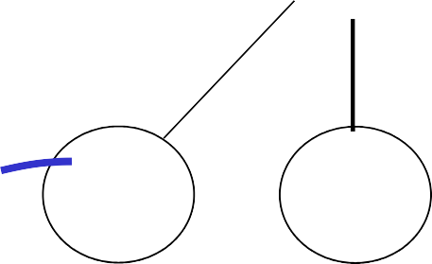


Exercise:
Can T2 access object f2.2 in X mode? What locks will T2 get?
T1(IX) _{R1}
t1
T1(IX)
t2
t4
t3
T1(X) f2.1
f2.2
f3.1
f3.2

Slide 84
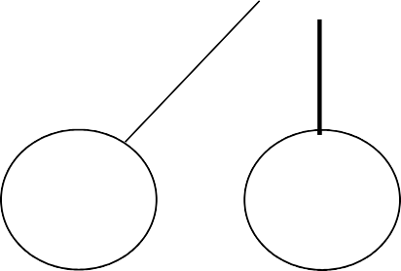
Exercise:
Can T2 access object f2.2 in X mode? What locks will T2 get?
T1(IX) _{R1}
t1
T1(X)
t2
t4
t3
f2.1
f2.2
f3.1
f3.2

Slide 85
Exercise:
Can T2 access object f3.1 in X mode? What locks will T2 get?
T1(IS) _{R1}
t1
T1(S)
t2
t4
t3
f2.1
f2.2
f3.1
f3.2

Slide 86
Exercise:
Can T2 access object f2.2 in S mode? What locks will T2 get?
T1(SIX) _{R1}
t1
T1(IX)
t2
t4
t3
T1(X) f2.1
f2.2
f3.1
f3.2

Slide 87
Exercise:
Can T2 access object f2.2 in X mode? What locks will T2 get?
T1(SIX) _{R1}
t1
T1(IX)
t2
t4
t3
T1(X) f2.1
f2.2
f3.1
f3.2

Slide 88
Insert + delete operations
A
Z
...
α
Insert

Slide 89
Modifications to locking rules:
Get exclusive lock on A before deleting A
At insert A operation by Ti, Ti is given exclusive lock on A

Slide 90

Still have a problem:
Example: relation R (E#,name,…)
constraint: E# is key use tuple locking
R E# Name …. o1
o2
55 | Smith
75 | Jones

Slide 91
T1: Insert <04,Kerry,…> into R T2: Insert <04,Bush,…> into R
T1 S1(o1)
T2
S2(o1)
S1(o2)
Check Constraint
S2(o2)
Check Constraint
...
...
Insert o3[04,Kerry,..]
Insert
o4[04,Bush,..]

Slide 92

Solution
Use multiple granularity tree
Before insert of node Q, lock parent(Q) in
X mode
R1
t1
t2
t3

Slide 93
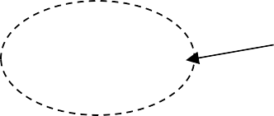
Back to example
T1: Insert<04,Kerry> T1
T2: Insert<04,Bush>
T2
X1(R)
X2(R)
delayed
Check constraint Insert<04,Kerry> U(R)
X2(R)
Check constraint
Oops! e# = 04 already in R!

Slide 94
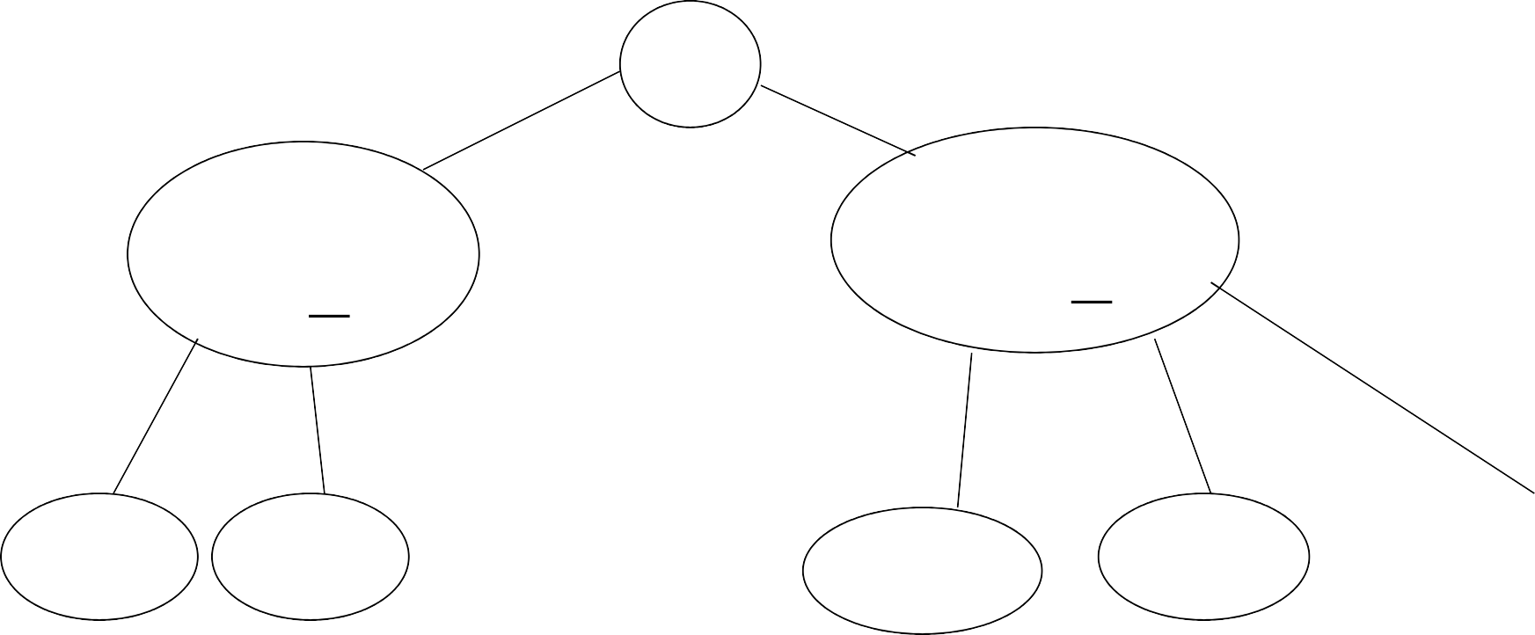
Instead of using R, can use index on R:
Example:
Index 0<E#<100
R
Index 100<E#<200
...
E#=2
E#=5
...
E#=109
...
E#=107

Slide 95
This approach can be generalized to multiple indexes...

Slide 96
Next:
Tree-based concurrency control
Validation concurrency control

Slide 97
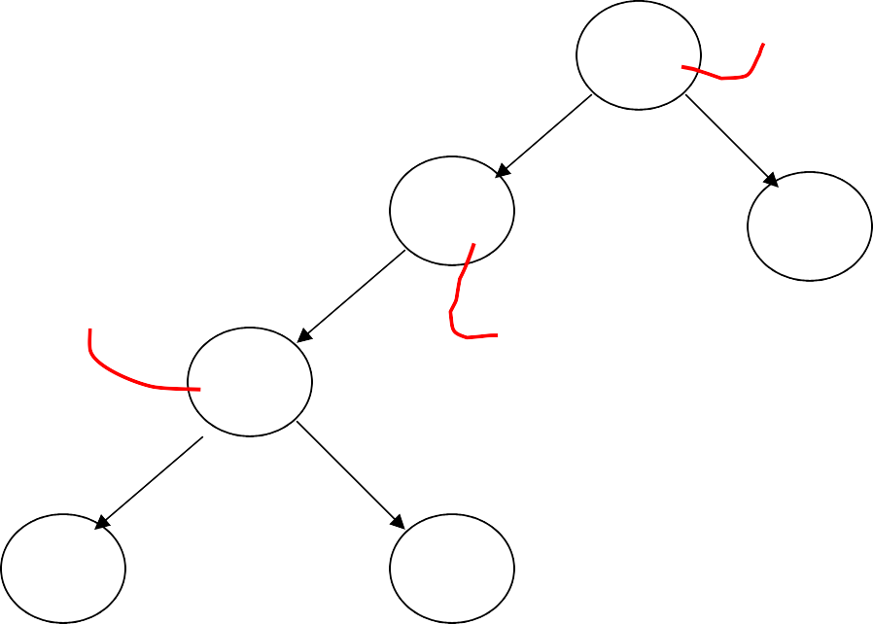
Example
all objects accessed through root, following pointers
T1 lock
A
B
C
T1 lock
T1 lock
D
E
F
 can we release A lock
if we no longer need A??

Slide 98
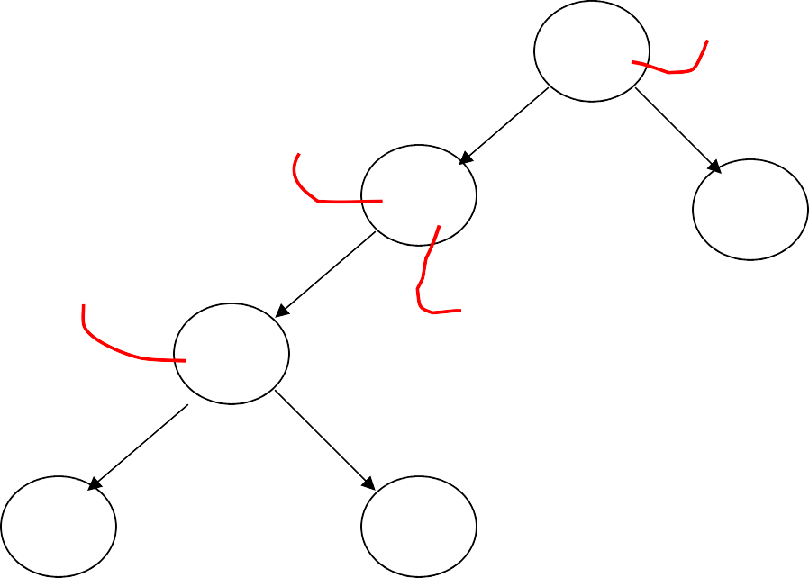



Idea: traverse like “Monkey Bars”
T1 lock
A
T1 lock
B
C
T1 lock
T1 lock
D
E
F

Slide 99
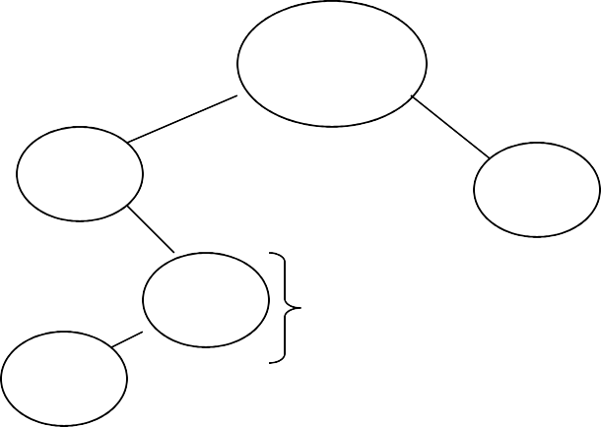
Why does this work?
Assume all Ti start at root; exclusive lock
Ti → Tj ⇒ Ti locks root before Tj
Root
Q
Ti → Tj
Actually works if we don’t always start at root

Slide 100
Rules: tree protocol (exclusive locks)
First lock by Ti may be on any item
After that, item Q can be locked by Ti only if parent(Q) locked by Ti
Items may be unlocked at any time
After Ti unlocks Q, it cannot relock Q

Slide 101
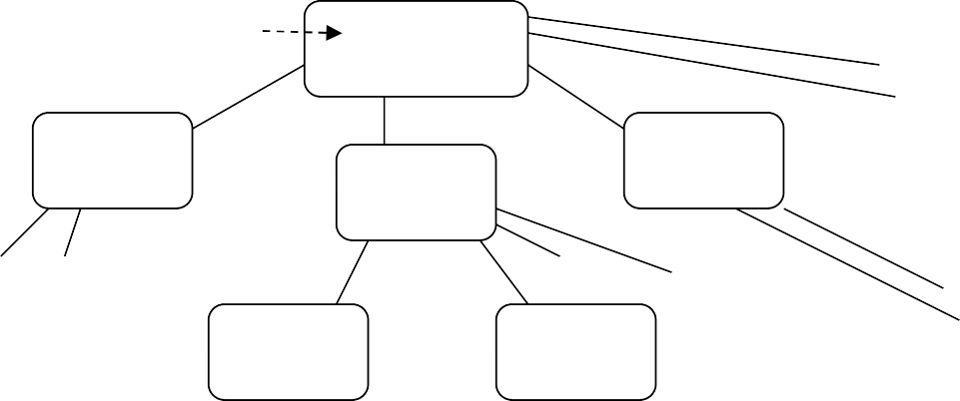
Tree-like protocols are used typically for B-tree concurrency control
Root
E.g., during insert, do not release parent lock, until you are certain child does not have to split

Slide 102
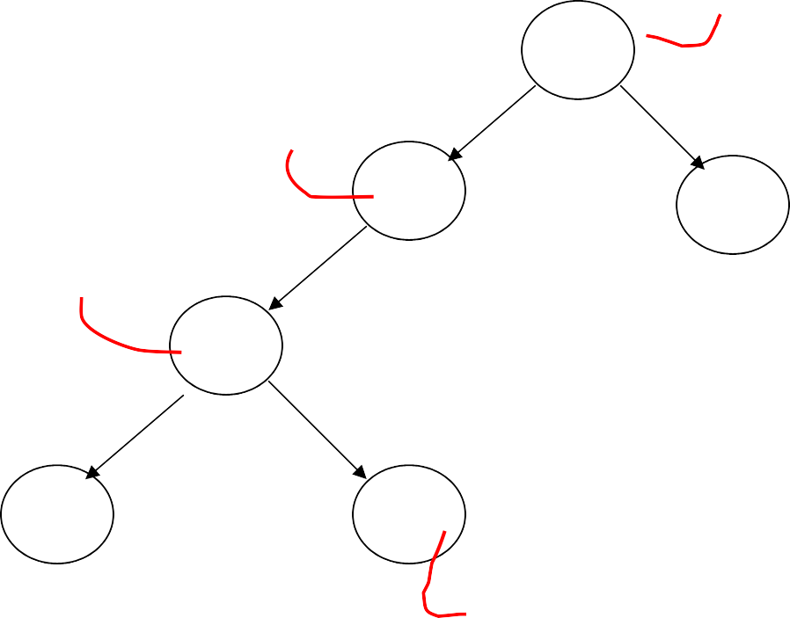
Tree Protocol with Shared Locks
Rules for shared & exclusive locks?
T1 S lock(released)
A
T1 X lock (released)
B
C
T1 S lock (held)
D
E
F
T1 X lock (will get)

Slide 103
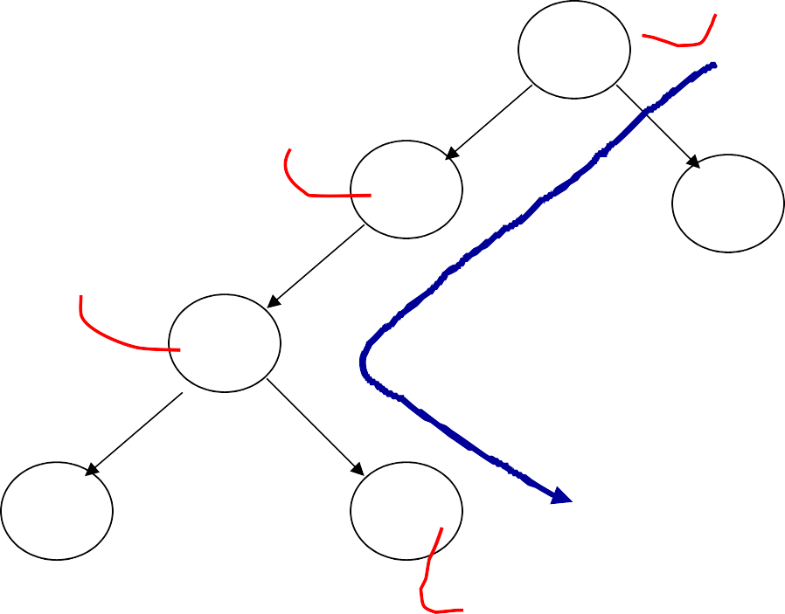
Tree Protocol with Shared Locks
Rules for shared & exclusive locks?
T1 S lock(released)
A
T1 X lock (released)
B
C
T2 reads:
B modified by T1
F not yet modified by T1
T1 S lock (held)
D
E
F
T1 X lock (will get)

Slide 104
Tree Protocol with Shared Locks
Need more restrictive protocol
Will this work??
Once T₁ locks one object in X mode, all further locks down the tree must be in X mode

Slide 105
Validation
Transactions have 3 phases:
Read
all DB values read
writes to temporary storage
no locking
Validate
check if schedule so far is serializable
Write
if validate ok, write to DB

Slide 106
Key idea
Make validation atomic
If T1, T2, T3, … is validation order, then resulting schedule will be conflict equivalent to Ss = T1 T2 T3...

Slide 107
To implement validation, system keeps two sets:
FIN = transactions that have finished phase 3 (and are all done)
VAL = transactions that have
successfully finished phase 2 (validation)

Slide 108
Example of what validation must prevent:
RS(T2)={B}
WS(T2)={B,D}
RS(T3)={A,B} = φ
WS(T3)={C}
∩
T2
start
T3
start
T2
validated
T3
validated
time

Slide 109

allow
Example of what validation must prevent:
RS(T2)={B}
WS(T2)={B,D}
RS(T3)={A,B} = φ
WS(T3)={C}
∩
T2
start
T3
start
T2
validated
T3
validated
T2
finish phase 3
T3
start
time

Slide 110
Another thing validation must prevent:
RS(T2)={A}
WS(T2)={D,E}
T2
validated
RS(T3)={A,B}
WS(T3)={C,D}
T3
validated
finish
T2
time
BAD: w3(D) w2(D)

Slide 111

allow Another thing validation must prevent:
RS(T2)={A}
WS(T2)={D,E}
T2
validated
finish
T2
RS(T3)={A,B}
WS(T3)={C,D}
T3
validated
finish
T2
time

Slide 112
Validation rules for Tj:
When Tj starts phase 1: ignore(Tj) ← FIN
at Tj Validation:
if check (Tj) then
[ VAL ← VAL U {Tj};
do write phase;
FIN ←FIN U {Tj} ]

Slide 113
Check (Tj):
For Ti ∈ VAL - IGNORE (Tj) DO
IF [ WS(Ti) ∩ RS(Tj) ≠ ∅ OR
Ti ∉ FIN ] THEN RETURN false; RETURN true;
Is this check too restrictive ?

Slide 114
Improving Check(Tj)
For Ti ∈ VAL - IGNORE (Tj) DO IF [ WS(Ti) ∩ RS(Tj) ≠ ∅ OR
(Ti ∉ FIN AND WS(Ti) ∩ WS(Tj) ≠ ∅)]
THEN RETURN false; RETURN true;

Slide 115












Exercise:
start validate finish
U: RS(U)={B}
WS(U)={D}
W: RS(W)={A,D}
WS(W)={A,C}
T: RS(T)={A,B}
WS(T)={A,C}
V: RS(V)={B}
WS(V)={D,E}

Slide 116
Validation (also called optimistic concurrency control) is useful in some cases:
Conflicts rare
System resources plentiful
Have real time constraints

Slide 117
Summary
Have studied C.C. mechanisms used in practice
2 PL
Multiple granularity
Tree (index) protocols
Validation

